Slide 1



Online Control Adaptation for Safe and Secure Autonomous Vehicle Operations
Mahmoud Elnaggar¹, Jason D. Hiser², Tony X. Lin³, Anh Nguyen-Tuong², Michele Co², Jack W. Davidson², and Nicola Bezzo^{1,3}
Notes:
What are the numbers for?

Slide 2
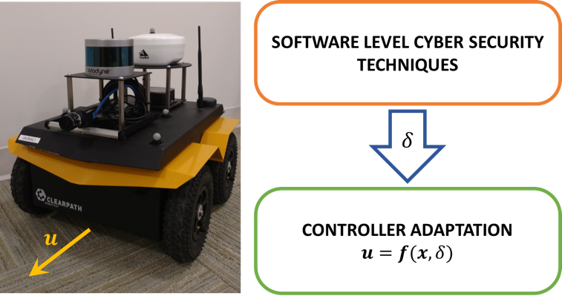

Online Control Adaptation for Safe and Secure Autonomous Vehicle Operations
MOTIVATION: Applying cyber security techniques to autonomous vehicles can incur runtime overheads that may result in unsafe performance of the autonomous vehicles.
PROBLEM: Online control performance adaptation for secure and safe navigation of autonomous vehicles.
RISK-BASED APPROACH:
Deployment of Cyber-security protection techniques.
Model Predictive Control to compute the inputs considering different delays.
Risk analysis: computation of a risk factor that indicates the accuracy of the estimated delay.
Computation of the adapted controller input.
The generated input is guaranteed to always drive the system toward safe states iff the delay is bounded between 0 and .
July 14, 2017
Notes:
Rim the video,
Move simulation to the 2nd slide
Add lemma to the first slide (showing that we can guarantee safety as long as delahy is less than delta_max)

Slide 3
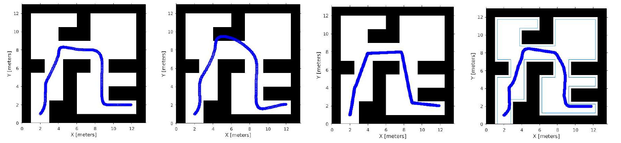
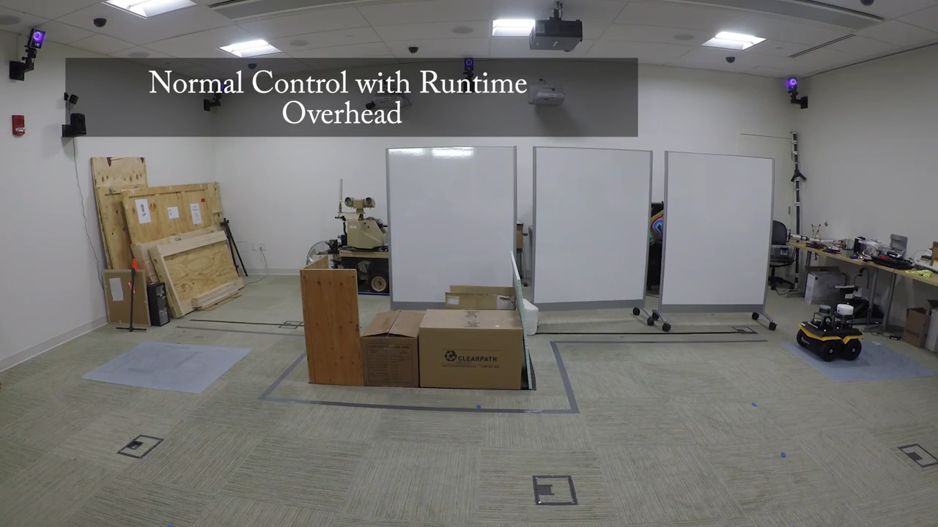
Online Control Adaptation for Safe and Secure Autonomous Vehicle Operations
SIMULATION RESULTS:
(a) No Overhead Delay (b) No adaptation (c) Conservative navigation (d) Adaptive navigation
EXPERIMENTAL RESULTS:
July 18, 2017
Notes:
- Go over simulation results
End the presentation with a concluding statement
Cut the videos in 2 parallel videos!
Add titles in the simulation snapshots

Slide 4

Online Control Adaptation
Risk-based approach:
Model Predictive Control to compute the inputs considering different delays
Risk analysis: computation of a risk factor that indicates the accuracy of the estimated delay
Computation of the adapted controller input
with:
The generated input is guaranteed to always drive the system toward safe states iff the delay is bounded between 0 and .
Notes:
- Adding cyber security techniques can incur runtime overheads that may results in unsafe performance of the system.
OUR APPROACH: Online control performance adaptation for secure and safe navigation of autonomous vehicles.
- By leveraging MPC, knowledge about the system dynamics, and the maximum performance degradation, our risk-based algorithm computes the control input to guarantee safety while maintaining a certain level of performance.

